Slide 1
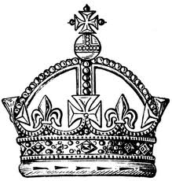
KINGDOM KIDS
Jesus is the King. He’s the King of the Earth,
The King of all creation, all the Universe.
The King of Love, the King of Joy
He wants us in His Kingdom,
every girl and every boy.
We’re the Kingdom Kids.
We’re the Kingdom Kids.
We’re the Kingdom Kids.
We’re the Kingdom Kids.

Slide 2
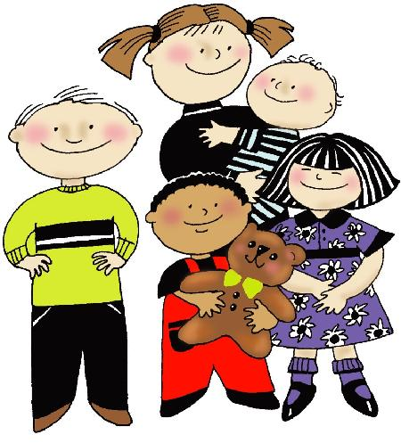
Je-sus. King of kings
Je-sus. Lord of lords.
Je-sus. King of love,
And we are the
children of His
Kingdom.

Slide 3
Jesus is the King. He’s the King of the Earth,
The King of all creation, all the Universe.
The King of Love, the King of Joy
He wants us in His Kingdom,
every girl and every boy.
We’re the Kingdom Kids.
We’re the Kingdom Kids.
We’re the Kingdom Kids.
We’re the Kingdom Kids.

Slide 4
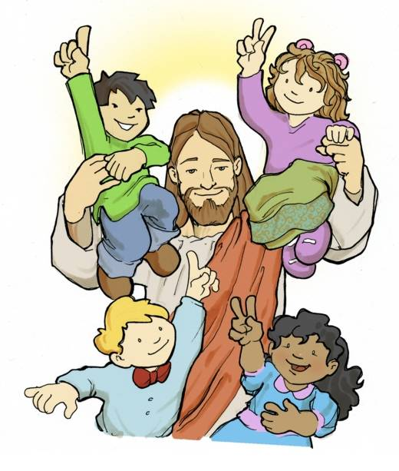
Je-sus. King of kings
Je-sus. Lord of lords.
Je-sus. King of love,
And we are the
children of His
Kingdom.
And we are the children of His Kingdom.

Slide 5
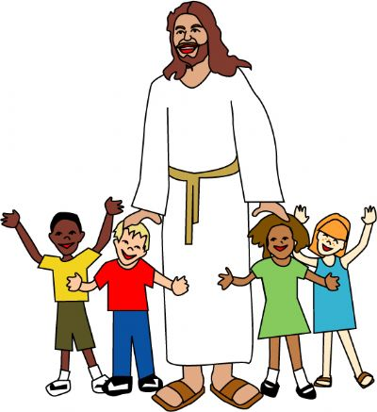
We’re the Kingdom Kids.
We’re the Kingdom Kids.
We’re the Kingdom Kids.
We’re the Kingdom Kids.
We’re the Kingdom Kids.
We’re the Kingdom Kids.
We’re the Kingdom Kids.
We’re the Kingdom Kids.
We’re the Kingdom Kids.
We’re the Kingdom Kids.

Slide 6
Je-sus. King of kings.
Je-sus. Lord of lords.
Je-sus. King of love,
And we are the children of His Kingdom.

Slide 7
Je-sus. King of kings
Je-sus. Lord of lords.
Je-sus. King of love,
And we are the
children of His
Kingdom.
We are the children
of His Kingdom.
We are the children
of His Kingdom.

